Slide 1


Case Study Analysis (North Zone Finals)
Presented By
Sajal Vats

Slide 2

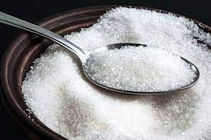




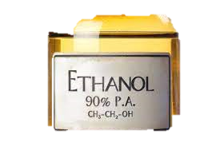

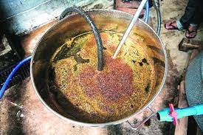
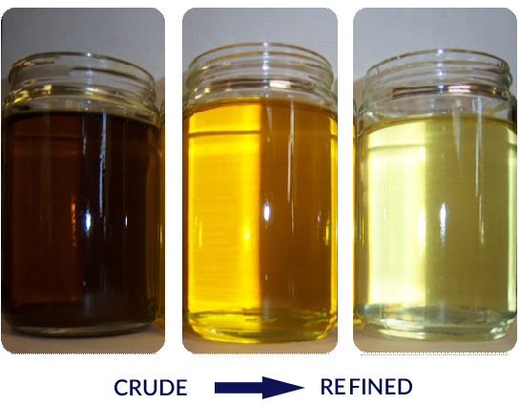
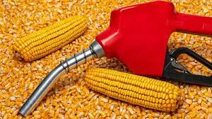


Article 1: India keeps edible oil import duty lower until March 2025, imposes 50% export tax on molasses
Why the 50% export tax on molasses?
Reasons for low edible oil import duties
After accounting for about 4 million tons(mt) of sugar diverted for
ethanol production, sugar production is expected to drop by 10% YOY, from 32.5 mt to 29mt
This drop is due to lower rainfall in major sugarcane producing states
The import duties on edible oils have been lowered to keep the prices of domestic market in check
India is world’s largest importer of vegetable oil
The domestic consumption is expected to be 28mt. Due to actual sugar production being marginally more than consumption forecast, government is discouraging use of sugarcane juice for ethanol production.
Other sources of ethanol production include sugarcane-based B heavy molasses, C heavy molasses, and grain-based sources
However, India’s edible oil imports have seen a 16% YOY drop. This drop is multifaceted in nature
Edible Oils consist of both crude oils and refined oils
The amount of sugar diverted is less when ethanol is produced from molasses
This means that the ethanol blending targets for the upcoming season would be met by ethanol supplied from molasses and grain-based sources
The price of molasses is about Rs 10K in the international market and a 50% export duty would render it uncompetitive
Edible oil exporting nations like Malaysia and Indonesia keep high export duties on crude oil and relatively low duties on refined oils
The 50% export duty on molasses would ensure its availability in the domestic market for ethanol production
Hence there has been a steep decline in the import of crude oil vis-à-vis the refined product, hampering the capacity utilization of domestic refining industry
Article 1 Analysis
Import Duty Decrease
Export Duty Increase (small country)
Export Duty Increase (large country)
Article 2 Analysis

Slide 3








Economic Impact of decrease in import duty on consumers and producers
Broadly, a decrease in import duties will lead to a fall in prices for domestic consumers and increase the import volume
Price
Let the initial price be P₂ with duty T. New price would be P₁ with the reduction in duty of t.
Imports at price P₂ equals (Q₃-Q₂) and imports at price P₁ equals (Q₄-Q₁)
S_{domestic}
At Price P₂
At Price P₁
Consumer Surplus
1+2
1+2+3+4+5+6
Producer Surplus
3+7
7
1
Government Surplus
T(Q₃-Q₁)
(T-t) (Q₄-Q₁)
2
S_{world}
P₂
t
3
There is a rise in consumer surplus of (3+4+5+6) and a fall in the producer surplus of (7)
5
4
6
S’_{world}
P₁
7
Original Imports
D_{domestic}
New Imports
For the economy, reduction in import duty leads to a net welfare gain of (4+5+6+Δ Govt revenue)
Quantity
Q₁
Q₂
Q₃
Q₄
Article 1 Analysis
Import Duty Decrease
Export Duty Increase (small country)
Export Duty Increase (large country)
Pricing Strategy
Article 2 Analysis

Slide 4




Economic Impact of increase in export duty on consumers and producers
Broadly, an increase in export duties will lead to a fall in prices for domestic consumers and enhance government revenue
The economic impact of increase in export duty would differ between small country (low share in export market) and large country (high share in export market)
Economic impact of increase in export duty by small country
Price
Due to his small size, the exporter would have to bear entire export duty rise
The exporter would prefer selling in domestic market until price in both domestic and foreign market falls to P_{world}-t
H
P_{world}
t
C
D
E
At Price P_{world}
At Price P_{world} - t
A
B
F
P_{world} - t
Consumer Surplus
H
H+A+B
P
N
Producer Surplus
A+B+C+D+E+P+N+M+G
G+M+N+P
M
G
Government Surplus
D
New Exports
There is a rise in consumer surplus of (A+B) and a fall in the producer surplus of (A+B+C+D+E)
Govt Revenue rises by D
Original Exports
When a small country imposes export duty, there net welfare loss in the economy equal to (C+E)
This is the Deadweight Loss (DWL)
Quantity
Q₁
Q₃
Q₄
Q₂
Article 1 Analysis
Import Duty Decrease
Export Duty Increase (small country)
Export Duty Increase (large country)
Article 2 Analysis

Slide 5



Economic Impact of increase in export duty by large country
India is the largest exporter of molasses
Export Duty would reduce the exports and decrease supply in international market. This would increase price in international market to P_{1w} from P_{w}
Price in the domestic market would be P₁w-t
At Price P_{w}
At Price P_{1w}-t
Consumer Surplus
K+J
K+J+A+B
Price
A+B+C+D+E+L+M+N
Producer Surplus
L+M+N
K
P_{1w}
D+H
Government Surplus
t
J
H
P_{w}
A
L
C
D
E
F
P_{1w}-t
N
B
M
There is a rise in consumer surplus of (A+B) and a fall in the producer surplus of (A+B+C+D+E)
Govt Revenue rises by D+H
When a large country imposes export duty, there net welfare change in the economy is equal to (H-C-E). This is ambiguous in terms of loss/gain
New exports
Original exports
Generally, a small export duty raises national welfare while a large export duty declines it
Quantity
Q₁
Q₃
Q₄
Q₂
Article 1 Analysis
Import Duty Decrease
Export Duty Increase (small country)
Export Duty Increase (large country)
Article 2 Analysis

Slide 6


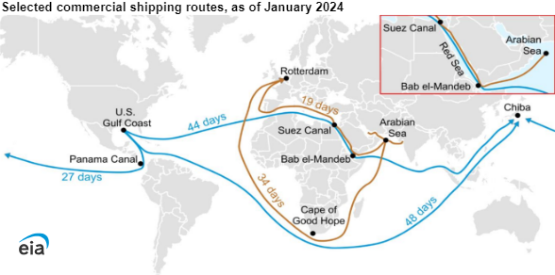

Article 2: India's sunoil imports to falter as Red Sea attacks lift freight costs
India is currently the largest importer of sunflower oil with majority of the supplies from South America and the Black Sea Region. The Black Sea Region consists of Russia, Ukraine, Georgia, Bulgaria, Romania, and Turkey. The major exporters in South America include Brazil and Argentina
Ships from Europe to Asia are avoiding the Red Sea routing and are taking the alternate route of Cape of Good Hope
Black Sea
This adds significant cost and time to the voyage
Adding to the trouble
Ships from US to Asia that generally take the Panama Canal are also rerouting to the Cape of Good Hope
This is due to the ongoing drought like condition in Panama Canal due to climate change
Brazil
The Panama crisis is further fueling the upward pressure on the freight rates of the African Horn route
Argentina
Post the Yemen based Houthi militia attacks on commercial ships transiting the Red Sea, many sunflower oil vessels originating from the Black Sea region chose to take longer, more costly route around the tip of Africa
Due to these disruptions, India would significantly ramp up soybean oil imports from South America to cover for the deficit in the sunflower oil imports from the Black Sea
This has led to about $130 rise in CIF price of sunflower oil and is selling at a premium to its nearest rival soybean oil. The former is further expected to lose import share to the latter as the conflict stretches
Article 1 Analysis
Import Duty Decrease
Export Duty Increase (small country)
Export Duty Increase (large country)
Article 2 Analysis

Slide 7





Use of commodity derivatives by edible oil companies to minimize price risk caused by global disruptions
Disruptions in sea routes have exposed edible oil companies to volatile prices and can hamper profits. To navigate this, commodity derivative contracts with edible oils as the underlying asset can be utilized by these firms to hedge their risks
Edible oil companies are short in the physical markets. Hence, they need to go long in derivates markets for hedging
There are two potential hedging instruments
When spot/futures price increase
Long Futures Contract
Profit
Long futures payoff
Long Call Option
Companies can hedge against possible increase in the edible oils underlying the futures contract by investing in a futures hedge
A buying hedge in the options market is achieved by purchasing a call option
Spot price
This is a buying hedge, also called a “long hedge” or “input hedge”. It enables the companies to lock-in the price of edible oils that are to be purchased in the future
Short physical payoff
This strategy provides protection against rising prices and provides opportunity to profit if price declines
Loss
When spot/futures price decrease
If price rises, maximum (ceiling) buying price = Call strike price + premium paid
Should the underlying commodity price rise, the gain in the value of the futures position will be able to offset the increase in purchasing cost in the spot market
Profit
Short physical payoff
If price falls, the company can buy from the spot market by letting the option expire and foregoing the premium.
A futures hedge is a “no profit no loss” proposition which precludes the opportunity to profit from favorable price movement.
This shortcoming can be overcome using options
Spot price
Long futures payoff
Buying a call and selling a put can minimize the premium cost. However, it sets a minimum(floor) purchase price
= Put Strike + Call premium-Put Premium
Loss
Export Duty Increase (small country)
Export Duty Increase (large country)
Article 2 Analysis
Using commodity derivates
Ideal Hedge Ratio

Slide 8





Ideal hedging ratio to cover the price risk exposure in the physical market (It should not be 100%)
The price movements for the commodity in the spot market will rarely correlate perfectly with the price movements of the futures contracts being used to hedge the commodity price risk
Though the direction of movement of spot and futures market is the same, rate of movement is rarely the same
This happens due to the presence of basis risk. Basis refers to the relationship of the spot price with the price of futures of a commodity. It is given by B = S_{t} - F_{(t,T)}
Basis risk can arise due to multiple reasons. Some of these include
Assuming a normal market and negative basis, if a trader is short in spot market and long in derivates market, he faces basis risk.
If the spot rate increases at a faster rate than futures, loss in spot markets will far exceed the profit in futures market.
This is referred to as narrowing/strengt -hening of the basis
Quantity Mismatch: Over-Hedging and Under-Hedging
Commodity Mismatch: Proxy Hedging
Delivery Date Mismatch
Hedge ratio refers to the proportion of positions taken in the futures to the size of the exposure in the spot market. It is denoted by “h”
Hedge ratio (h) = (Size of futures position) / Size of exposure
The optimal ratio need not always be 1
Mathematically, h = ρ X σS/σF
Here σS is the standard deviation of the change in the spot price during the hedging period
σF is the standard deviation of change in the futures price, and
ρ is the coefficient of correlation between change in spot price and futures price
If the spot contract to be hedged matures in a very distant future, we can roll the hedge forward
This involves using strip hedges (series of contracts) or stack hedges (one-year contracts)
Export Duty Increase (small country)
Export Duty Increase (large country)
Article 2 Analysis
Using commodity derivates
Ideal Hedge Ratio

Slide 9
THANK YOU
References
Economic Times
Business Standard
US Energy Information Administration (EIA)
Reuters
Hindu Business Line

